Slide 1
CT1017 - Simplify UI App hosting with Application Frontend Service
Shrinivasan Neelamegam
Developer Advocate, SAP
26th November, 2025, 14:30 hrs
Community Theater, SAP TechEd Bengaluru 2025
Add partner
logo and alt text

Slide 2


Agenda
Application Frontend - Introduction
Architecture
Pre-requisites for setup
Code walkthrough & Demo
Reference material and resources

Slide 3
App Frontend - Introduction
New SaaS application on SAP Business Technology Platform (BTP) for hosting, serving and operating frontend applications
Agnostic to the tools, development model, and UI frameworks that are used to develop UI applications
Host-based routing, the versioning concept and a direct deployment option
Part of SAP Build license
Available in 20 main regions including the BTP Trial landscape(US10)

Slide 4
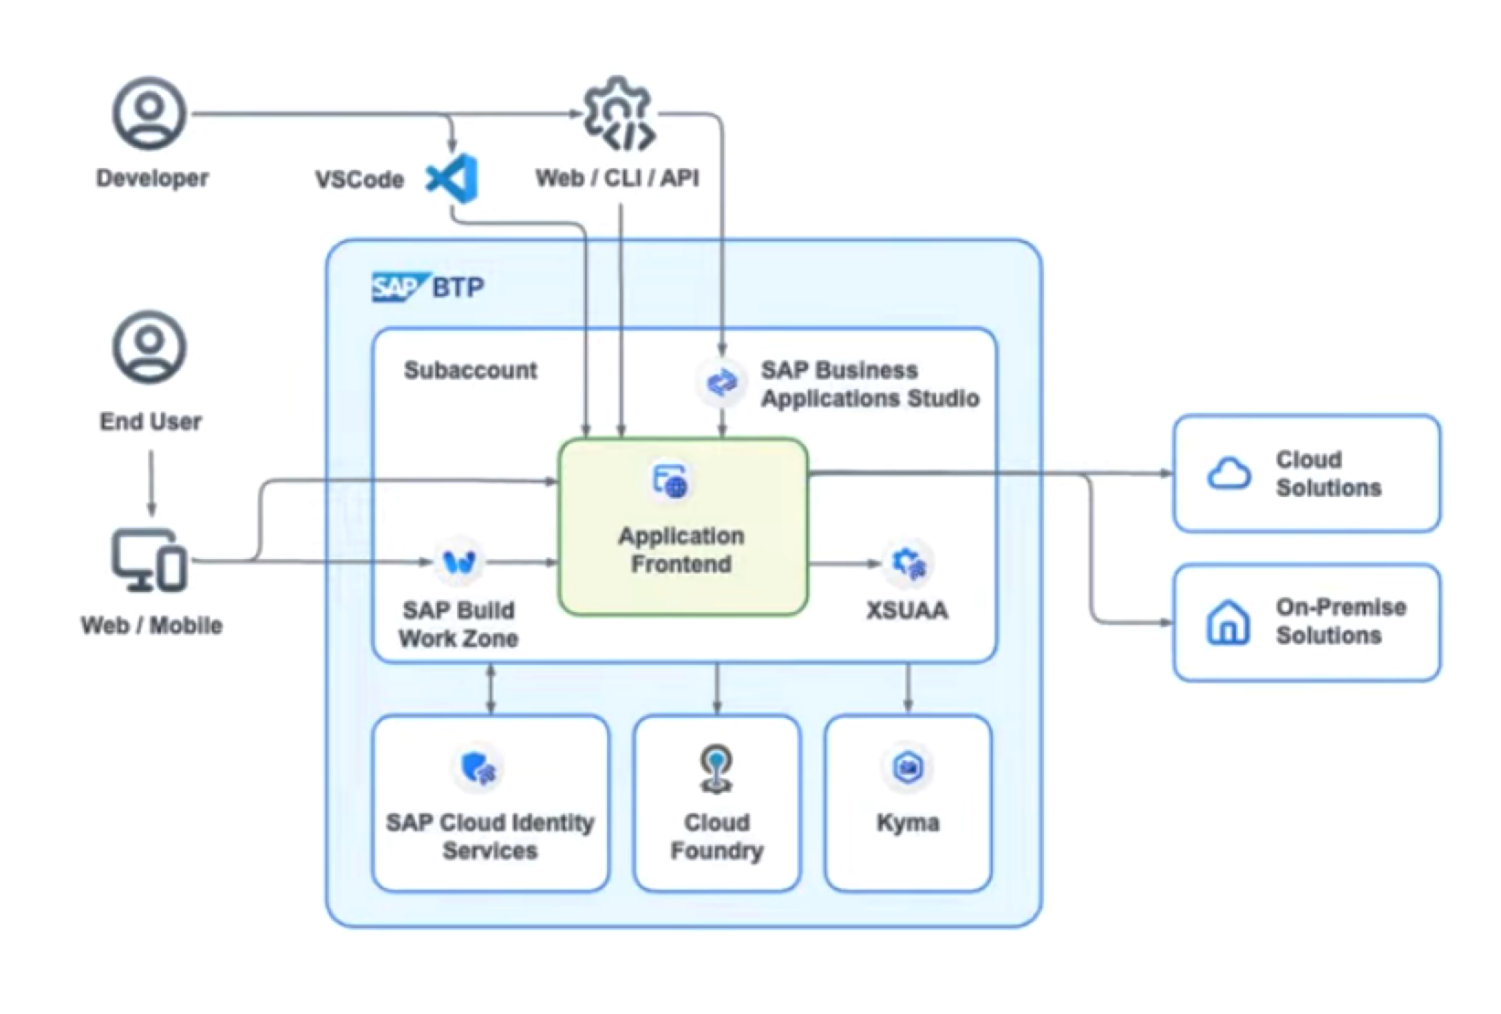
Architecture

Slide 5
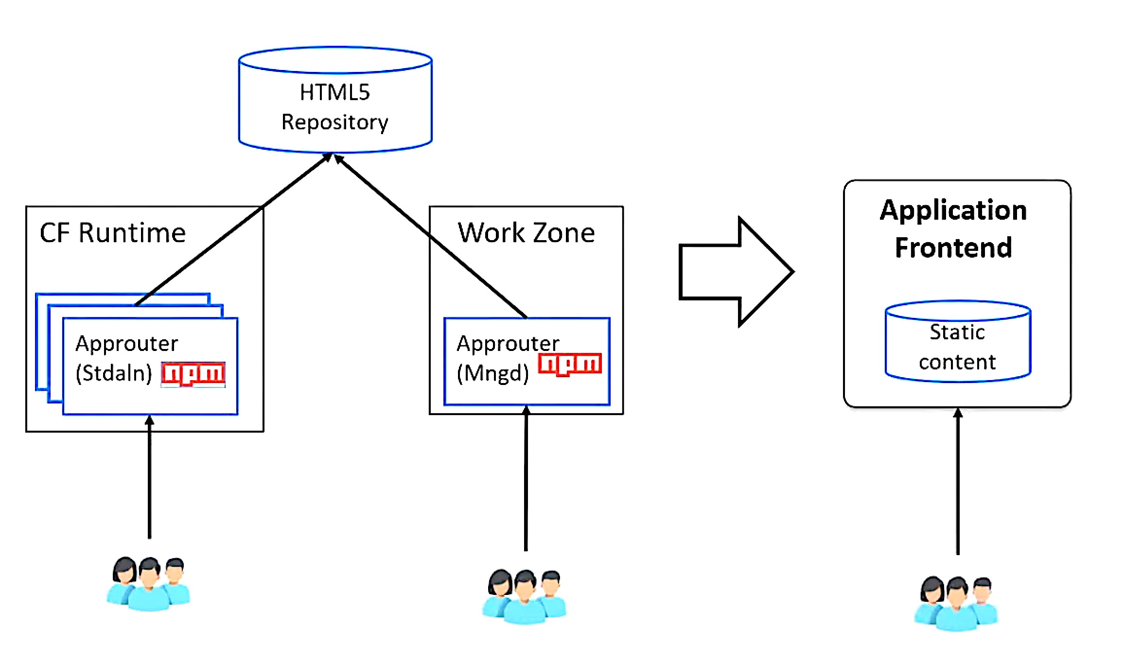
Current vs New
Static content
Note: Both approaches will exist going forward, with App Frontend becoming the primary approach at some point in future
Notes:
Zero Down-Time Enablement : The HTML5 applications are decoupled from the consuming application router. This enables updating the static content of the HTML5 applications without restarting the application router.
The application router is the single point-of-entry for an application running in the Cloud Foundry environment on SAP BTP. The application router is used to serve static content, authenticate users, rewrite URLs, and forward or proxy requests to other micro services while propagating user information. https://help.sap.com/docs/btp/sap-business-technology-platform/integration-with-html5-application-repository
The managed application router enables you to access and run HTML5 applications in a cloud environment without the need to maintain your own runtime infrastructure.

Slide 6
Pre-requisites
build-default subscription of Application Frontend, Trial plan subscription if using BTP Free Trial
Subscribe to SAP Cloud Identity tenant (default), establish Trust
Business Application Studio(standard) or Visual Studio Code or CLI
Node.js v22.6.0 as minimum version
Application Frontend service CLI tool—afctl
Role: Application_Frontend_Developer

Slide 7
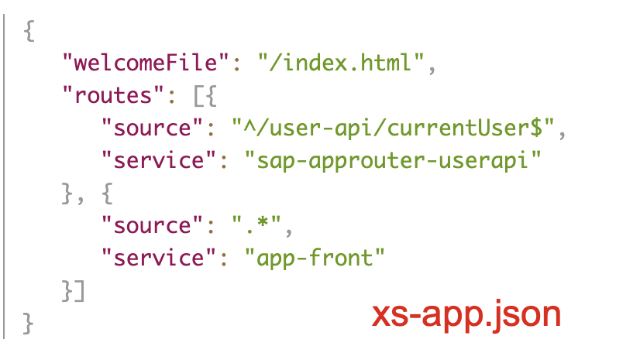
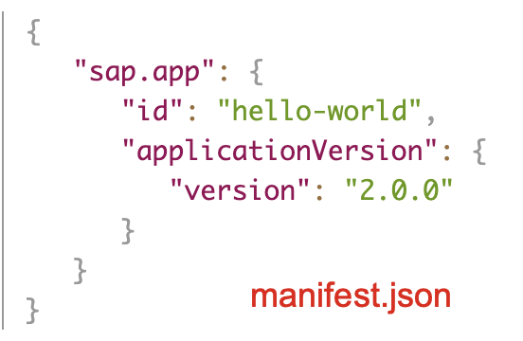
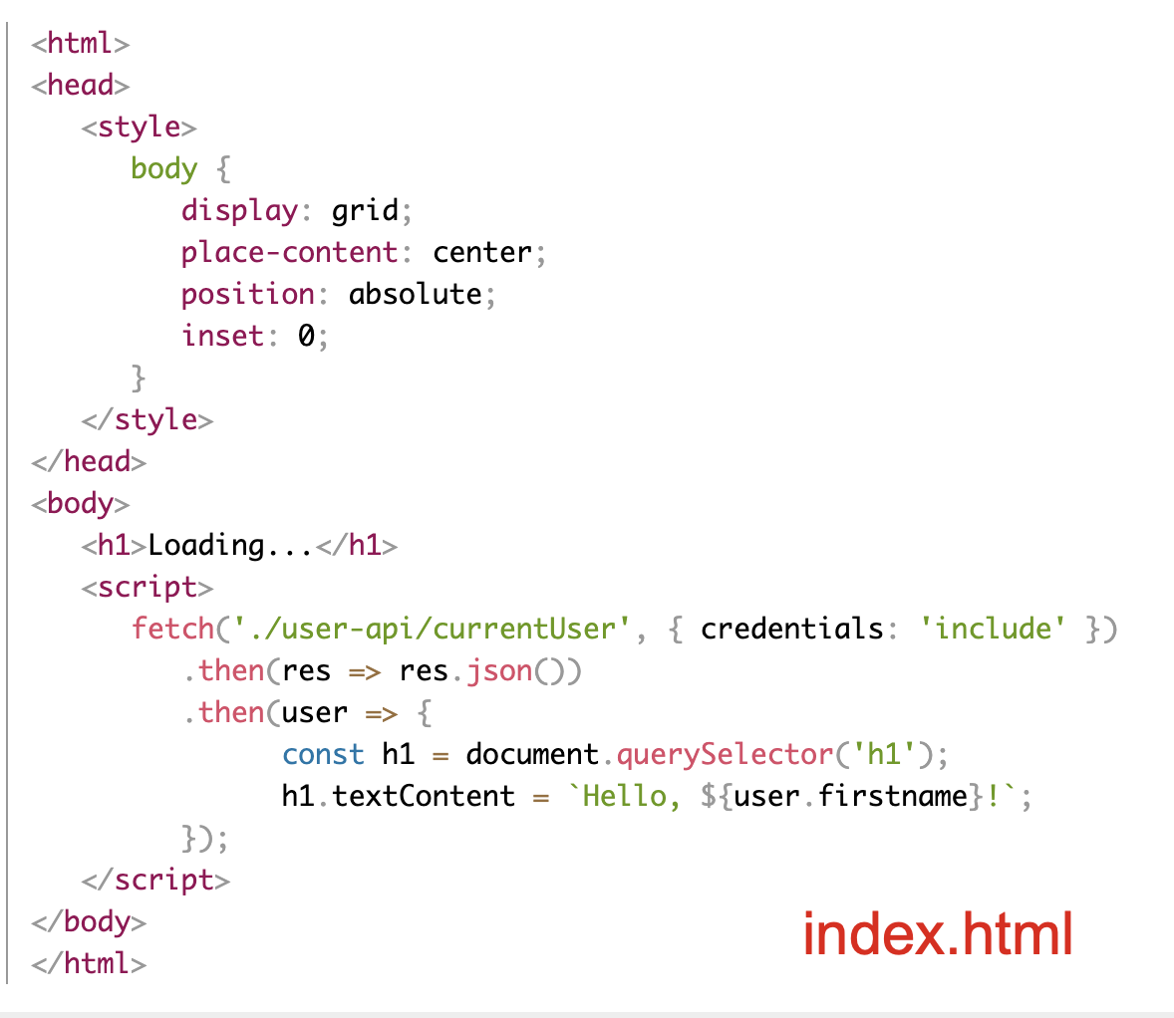
Minimum files required
manifest.json
xs-app.json
index.html

Slide 8
Demo

Slide 9
Limitation
You can deploy a maximum number of 10 versions of an application
  One version can be active at a time, that version is available for end users
  When you have reached this limit, you must delete an older version before deploying a new one
Trial accounts are limited to five applications per subaccount
Deployment to cloud foundry from BAS is possible only with ‘standard-edition’ not Trial edition, deployment possible with afctl cli in BTP Trial

Slide 10
References
Blog post: https://community.sap.com/t5/technology-blog-posts-by-sap/introducing-application-frontend-service/ba-p/14091408
Introduction Tutorial: https://community.sap.com/t5/technology-blog-posts-by-sap/simple-ui-applications-with-application-frontend-service/ba-p/14096009
Help portal : https://help.sap.com/docs/application-frontend-service/application-frontend-service/what-is-application-frontend-service
Devtoberfest Session on YouTube: https://www.youtube.com/watch?v=cqRC6_50tlE
Tutorials on Tutorial Navigator System:
  https://developers.sap.com/tutorials/application-frontend-trial-setup.html
  https://developers.sap.com/tutorials/application-frontend-cli.html
  https://developers.sap.com/tutorials/application-frontend-mta.html
  https://developers.sap.com/group.build-deploy-ui5-cli-frontend-service.html

Slide 11

Shrinivasan Neelamegam
Community: shrinivasan_neelamegam
LinkedIn:
shrinivasan-neelamegam

